Slide 1

7 BILLION PEOPLE
200 COUNTRIES
ALL PRODUCING DATA
Engineering Computation
& Data Science
Abel Sanchez, abel@mit.edu, John R Williams, jrw@mit.edu
Massachusetts Institute of Technology

Slide 2
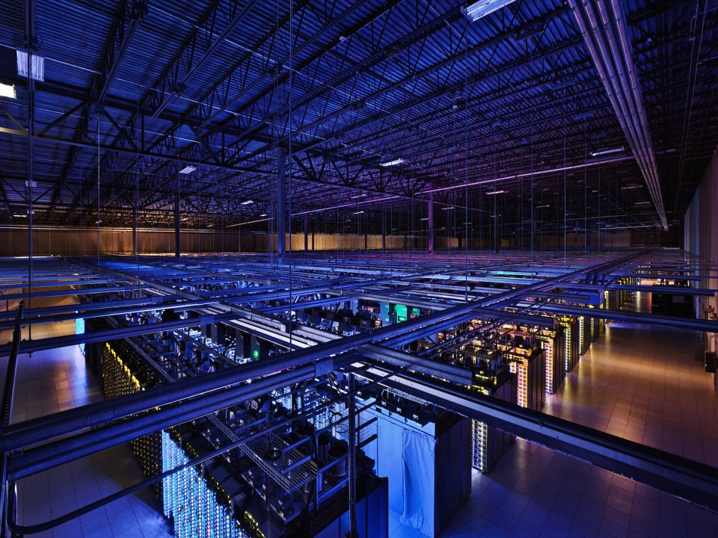
Rise of Systems & Data

Slide 3
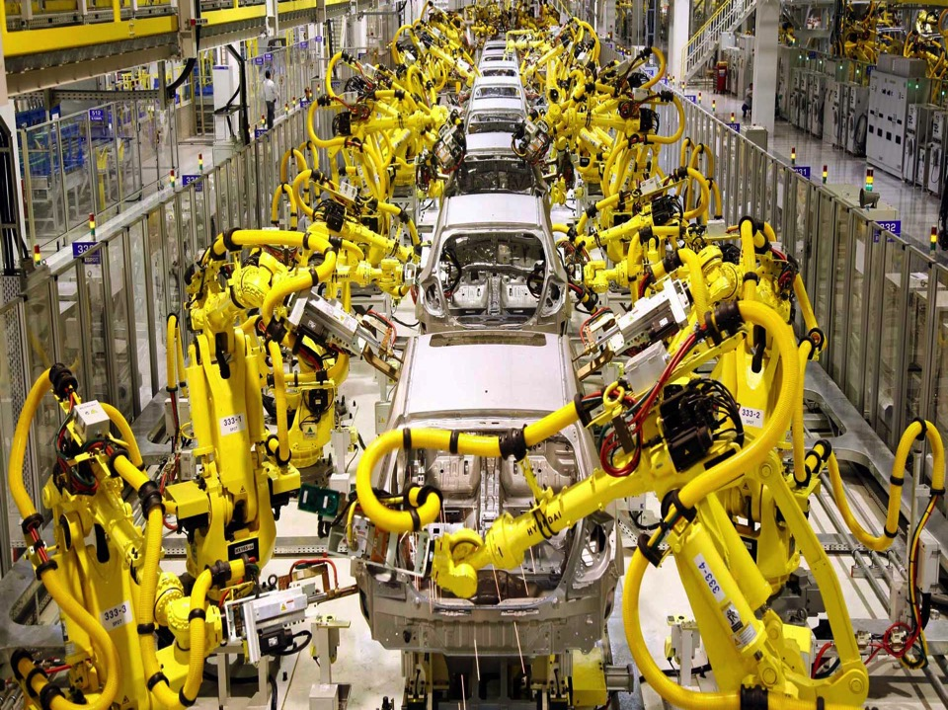
More Systems & More Data

Slide 4




Everywhere

Slide 5

Abstractions for Building
Software Systems Have Risen

Slide 6

New normal: A Single Person can
Build a Complex Software System

Slide 7

New normal: A Small Team can
Challenge an Industry

Slide 8
A New Challenge
for All

Slide 9

Challenge: develop the ability to conceptualize and represent problems in a way that a computer can solve.

Slide 10

The ability to formulate a problem in a way that a computer can solve it is fundamental to the modern practice of engineering.

Slide 11

Posing your idea in terms of computation is much more than being able to program a computer. It requires thinking in terms of systems.

Slide 12


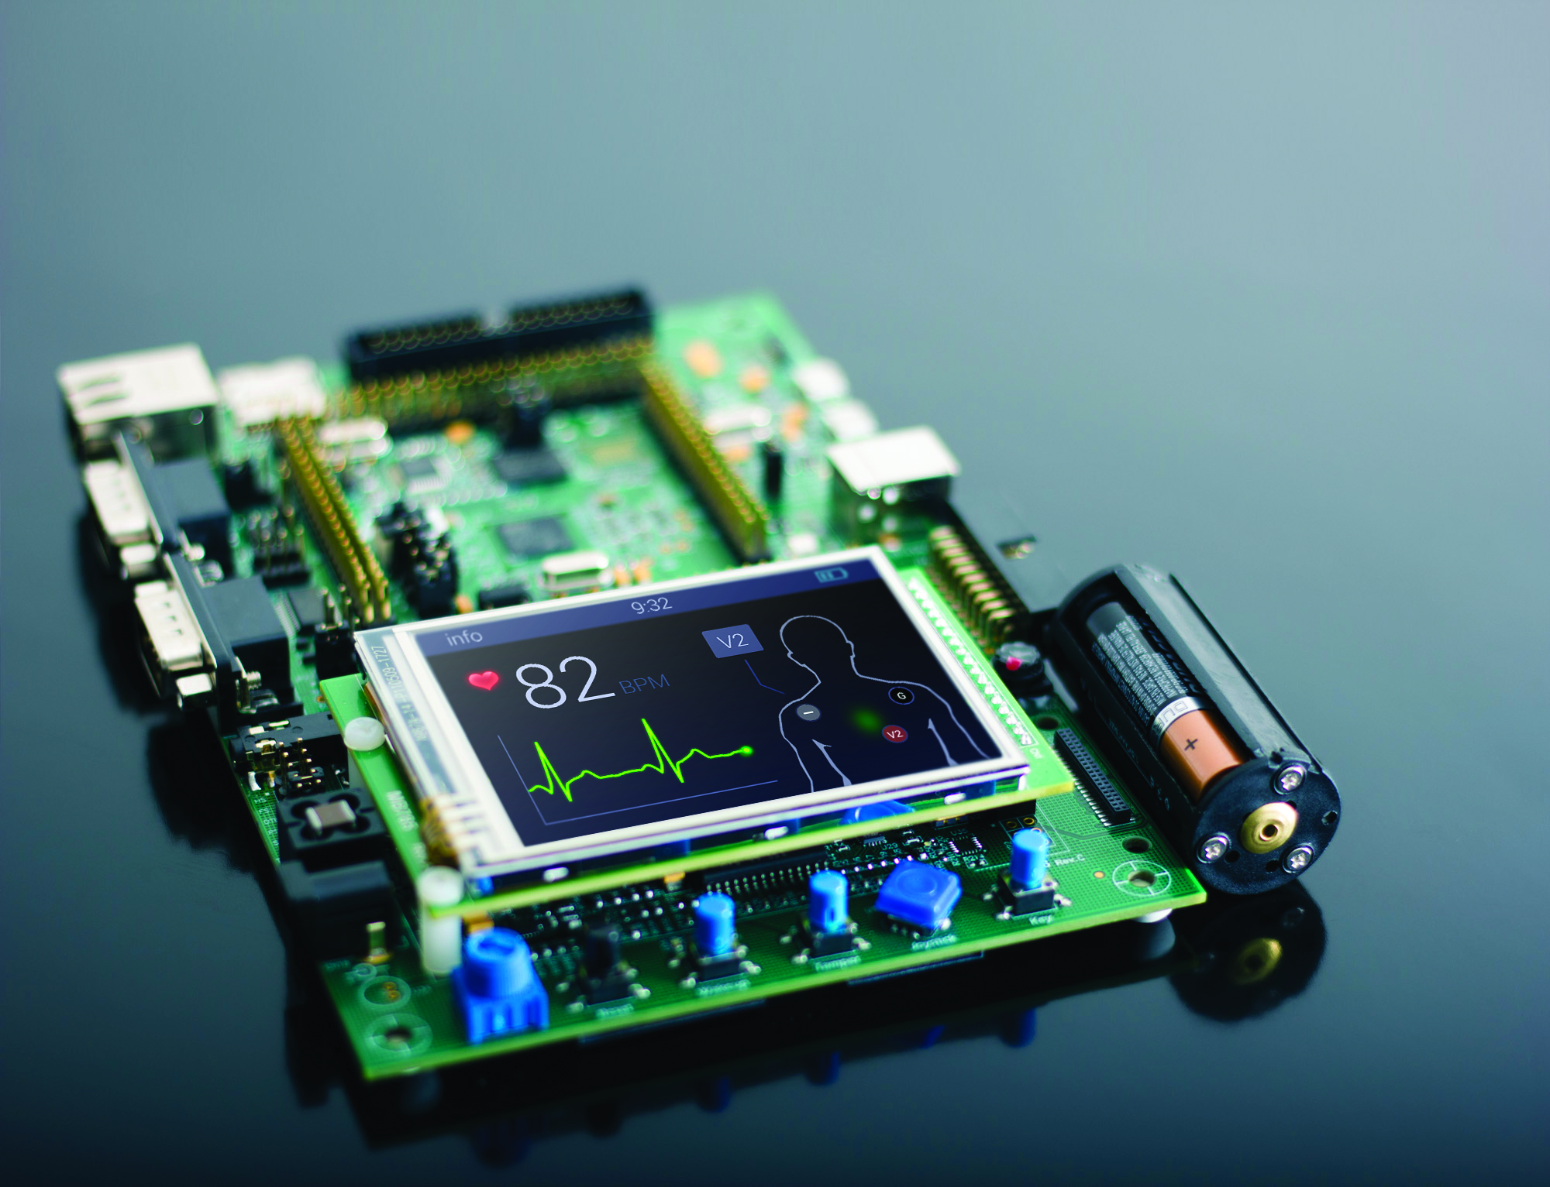

Blockchain
Data
Science
IOT
Machine
Learning
NEW PILLARS

Slide 13



Voice
X Reality
Security
NEW PILLARS

